Slide 1


Making Everyday Things Smart
Lego for Engineers and Computer Scientists
Profs. Ivan Lee and Phillipa Gill
College of Information and Computer Sciences
UMass Amherst

Slide 2

Sponsors

Slide 3
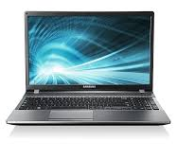
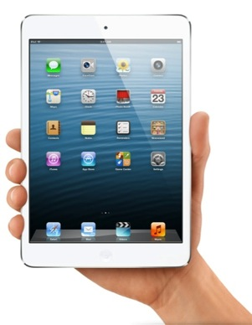
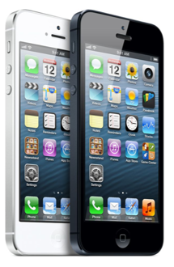
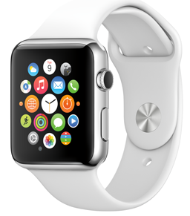
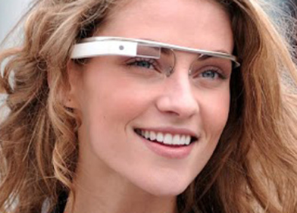
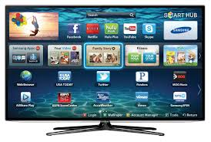
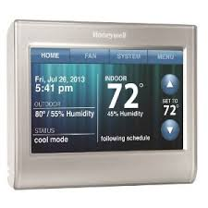
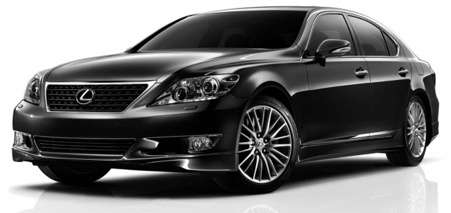

Slide 4




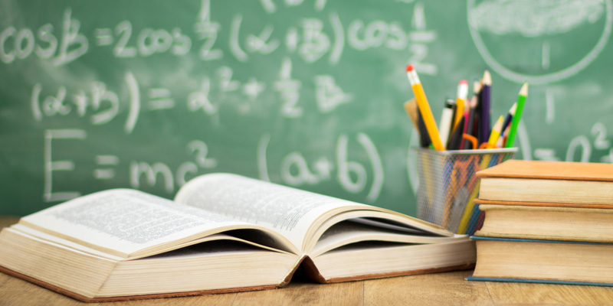
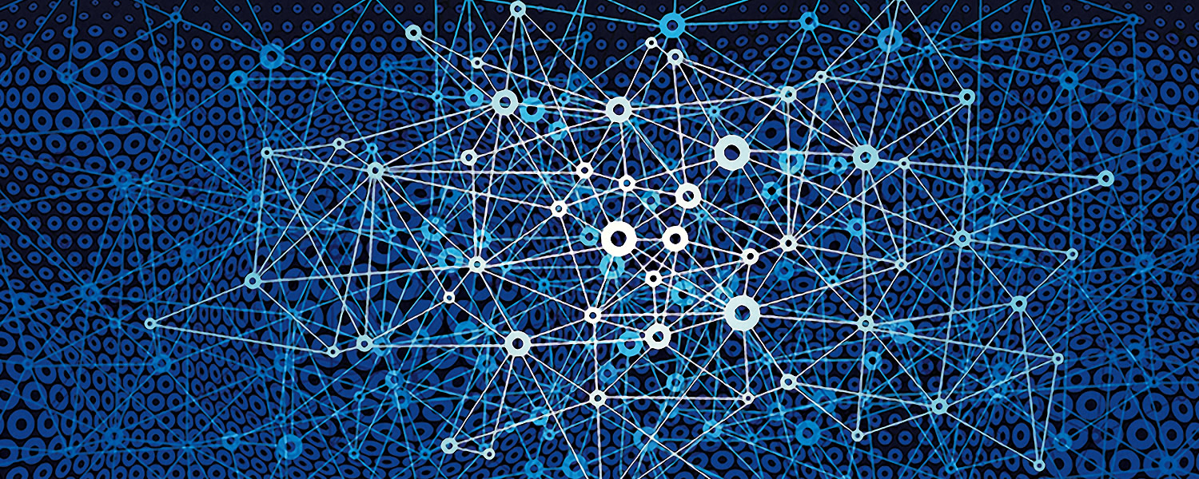

Slide 5
Technology can also be used to create!
Notes:
Image source: https://journal.burningman.org/2015/12/burning-man-arts/brc-art/christopher-schardt-from-engineering-to-aesthetics/

Slide 6

Technology can also be used to create!

Slide 7
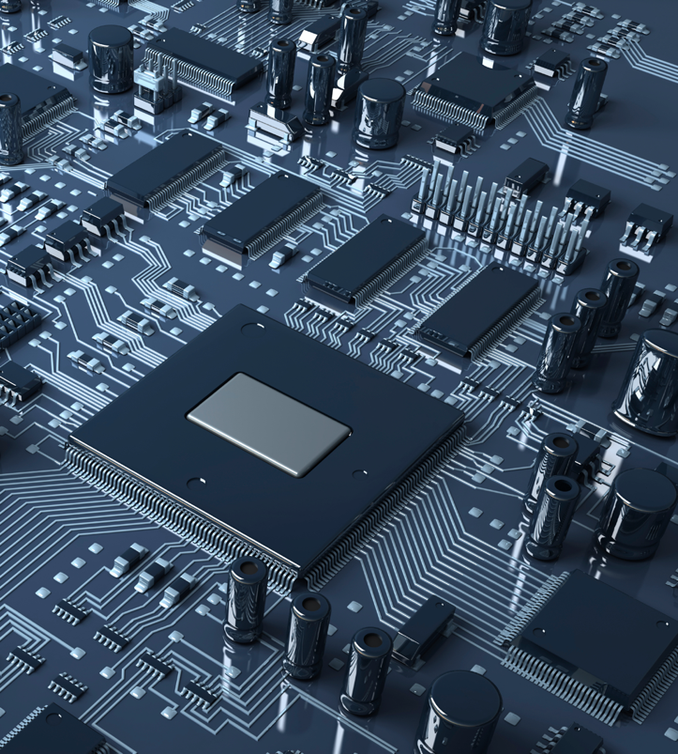
What is Programming?
Add 010100000000
Load A 010101000000
Divide 010111000000
Extract 011000000000
Load F 011001000000
Store F 011010000000
Store A 011011000000
Store X 100100000000
Move A 100101000000
Load L 100110000000
Multiply 100111000000
Subtract 110101000000
Notes:
How to tell the computer what to do?

Slide 8
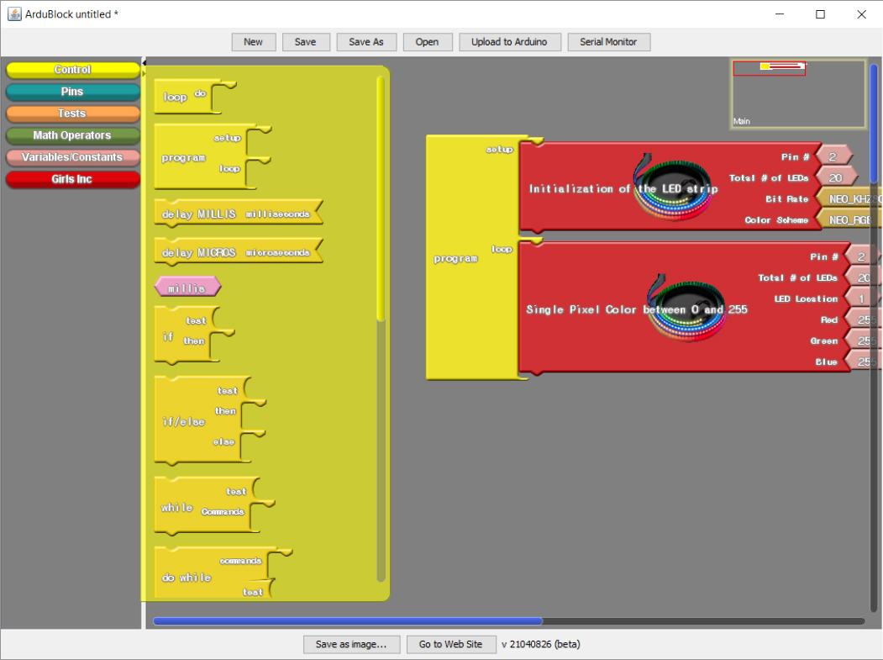
Block Categories
Blocks
Code

Slide 9
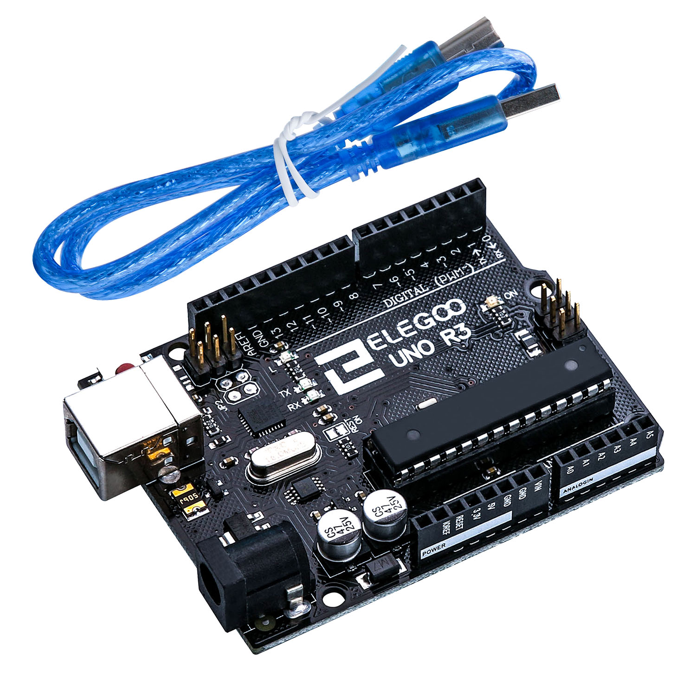
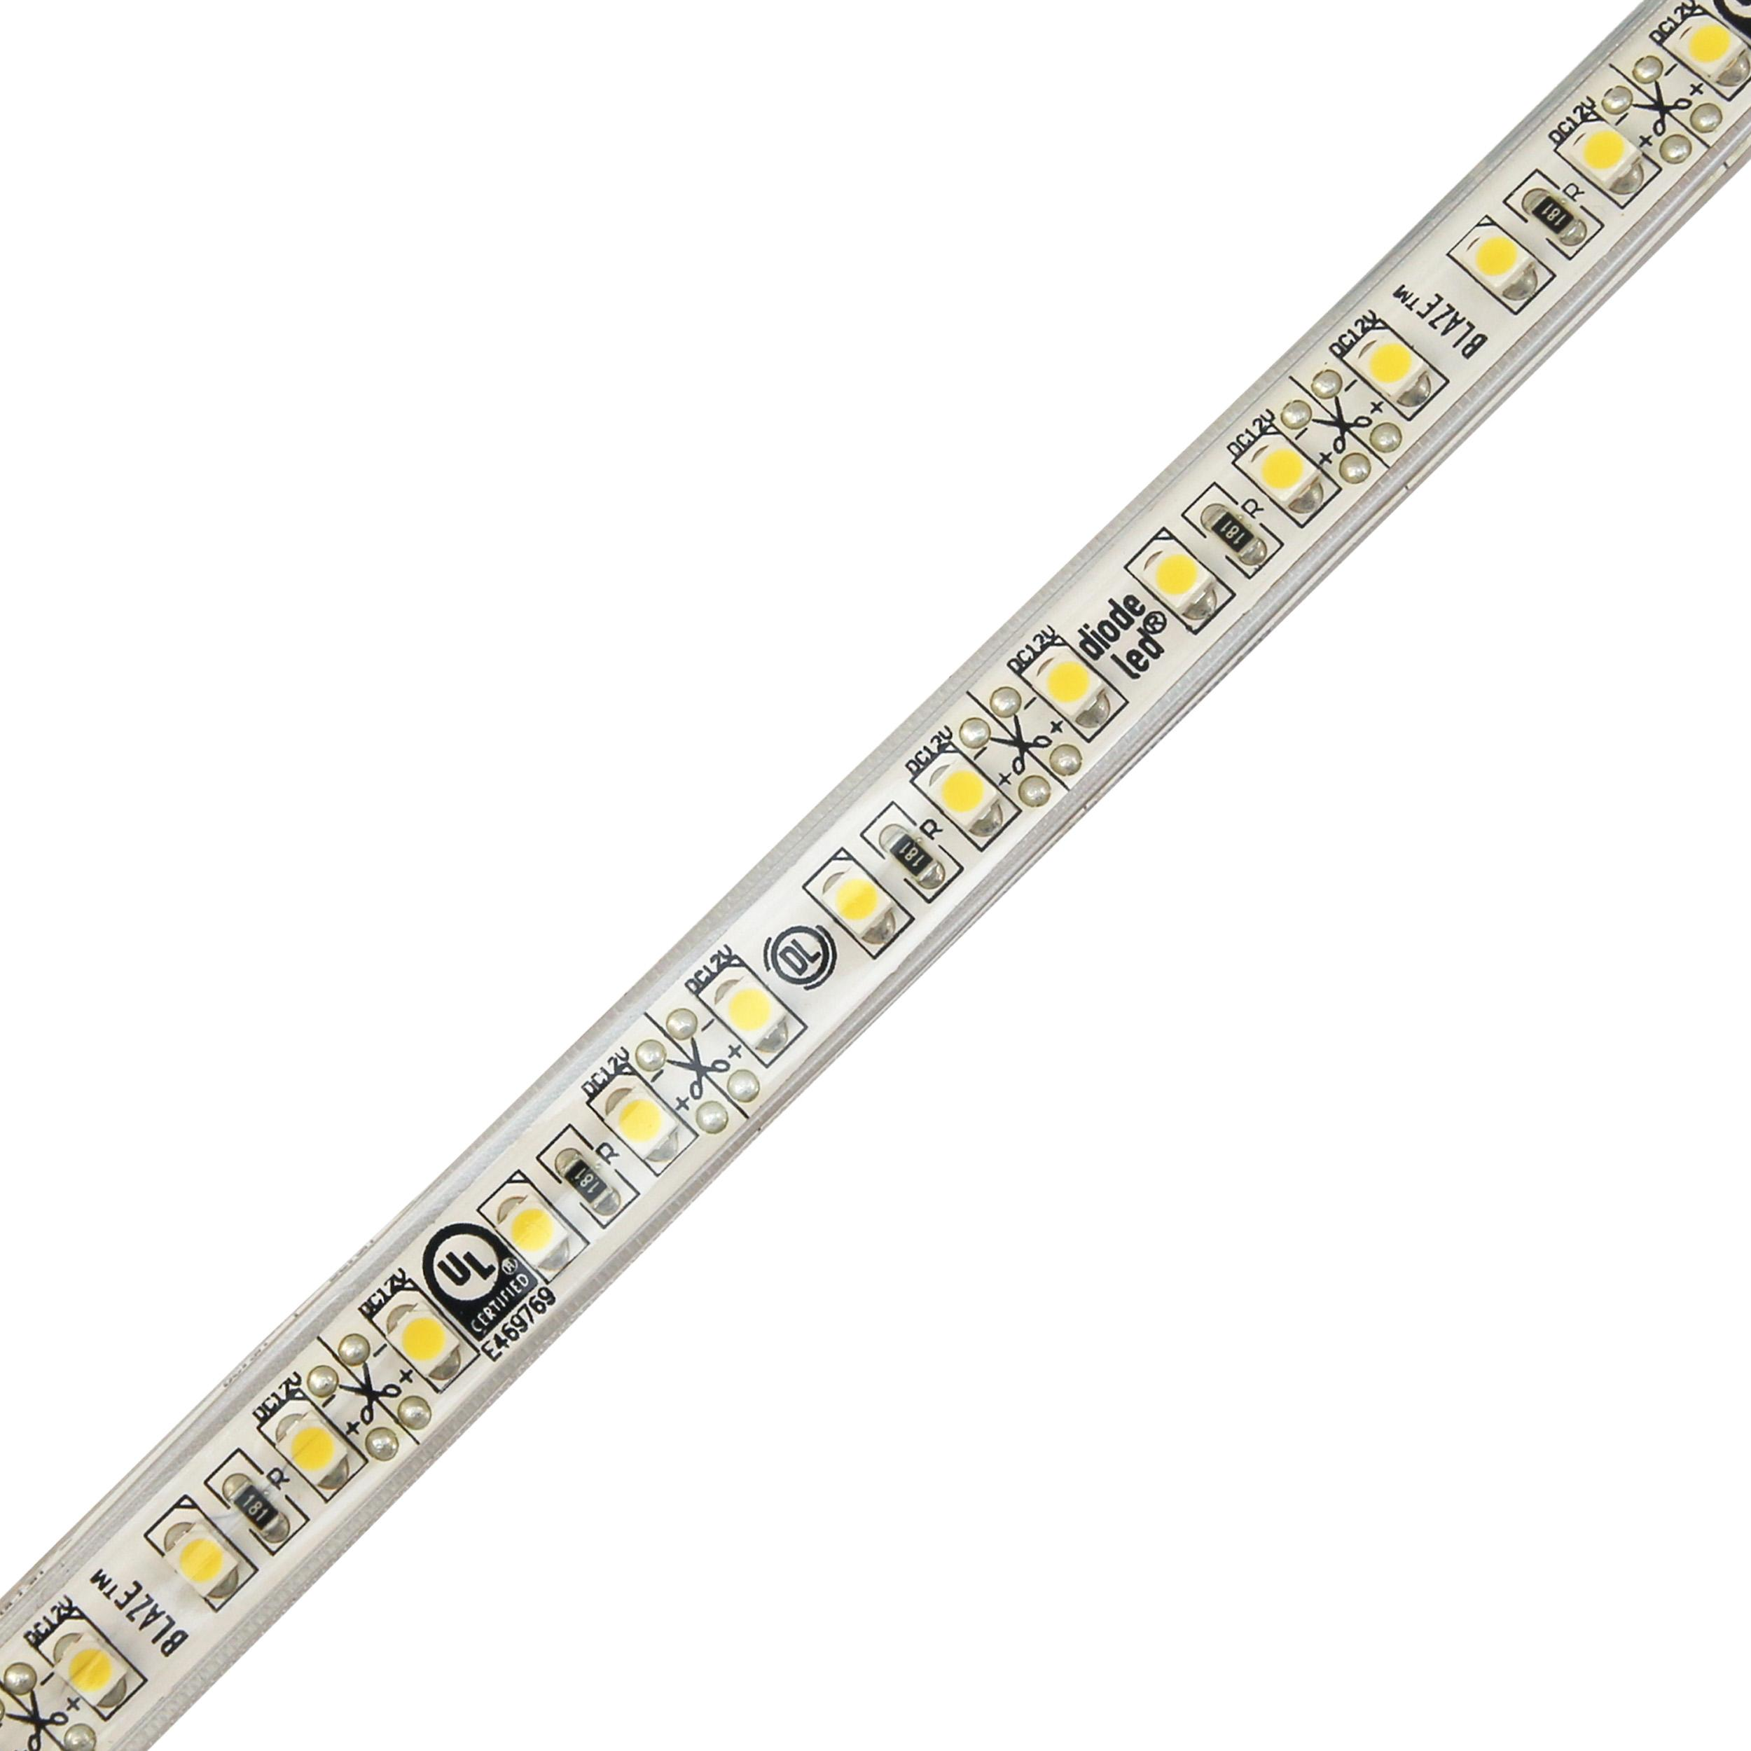
Arduino
LED strip

Slide 10
Brain
(software)
Body
(hardware)
Tool
(sensor)

Slide 11
Demo

Slide 12
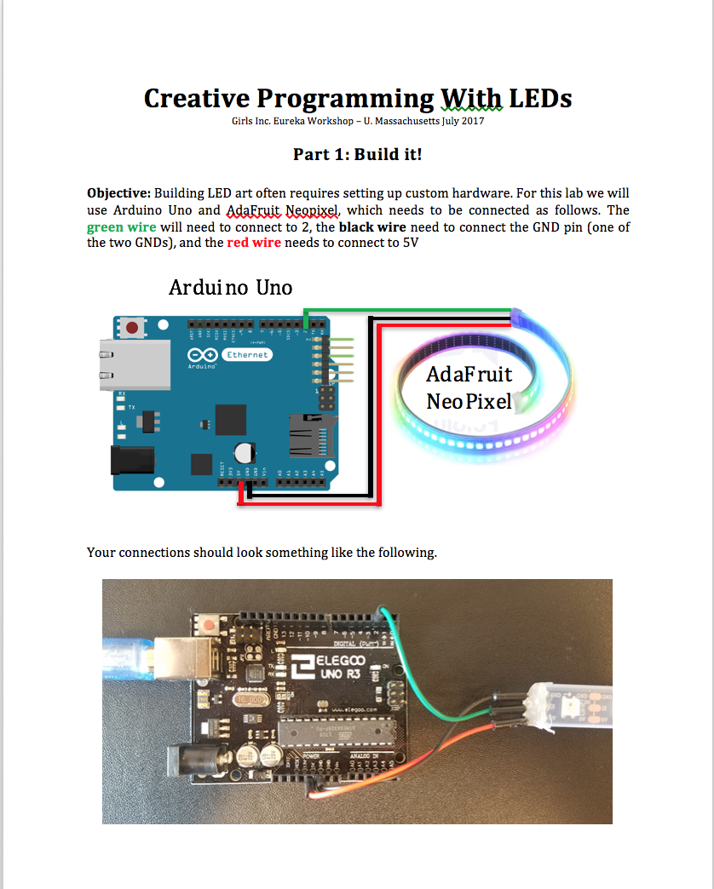
Instructions

Slide 13
Work Together
Ask Questions
Have Fun!

